Slide 1

Foundation Physics
Report Writing Workshop:
Part I Writing Reports in Word
Part II Representing Data with Excel

Slide 2
Tutorial Overview
Part I Writing Reports in Word
Slides pp. 4-6 : Aims of today’s workshop (Part I)
Slides pp. 7-18 : Equation editor: illustration and practice
Slides pp. 19-23 : Instructions on downloading & saving
Slides pp. 24-59 : Main Tutorial for Report (Criteria 1-6 starting page: p.24, p.33, p.36, p.40, p.45, p.49)
Part II Representing Data with Excel
Slides pp. 61-62 : Aims of today’s workshop (Part II)
Slides pp. 63-68 : Introduction and task briefing
Slides pp. 69-141 : Main Tutorial for Spreadsheet (Task 1-5 starting page: p.70, p.100, p.111, p.127, p.139)
❕ Disclaimer: You understand this tutorial would only apply if you work via University software (MS Word, PowerPoint, Excel) with English as the system language.

Slide 3
Workshop Part I
Writing Reports in Word

Slide 4
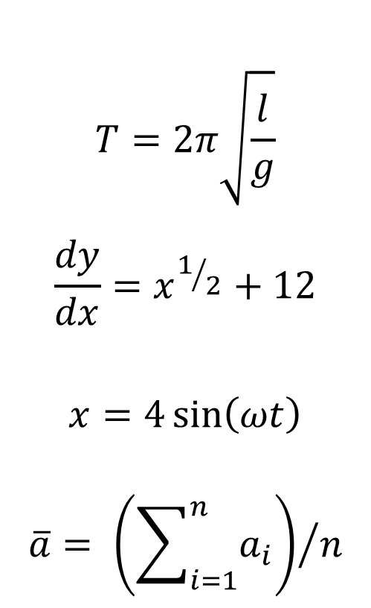
Aims of Today’s Workshop (Part I)
To produce equations using Microsoft equation editor.

Slide 5
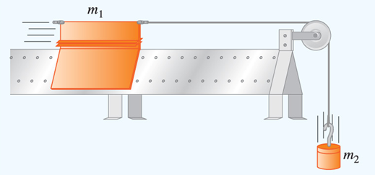
Aims of Today’s Workshop (Part I)
To acquire the necessary skills to correctly format a word-processed report.
To acquire the skills to produce/edit diagrams for use in reports.

Slide 6
Introduction
One of the most important skills you will develop in your first year of study is how to produce a high-quality scientific report based upon an experiment.
You will be given an example of such a scientific report (“Report 2XXXXXX.docx”). However, the formatting and presentation of the report is poor, incomplete, and the equations are missing.
The following tutorial has been developed to show you how to produce a well-presented, word processed report and how to type up equations professionally.

Slide 7
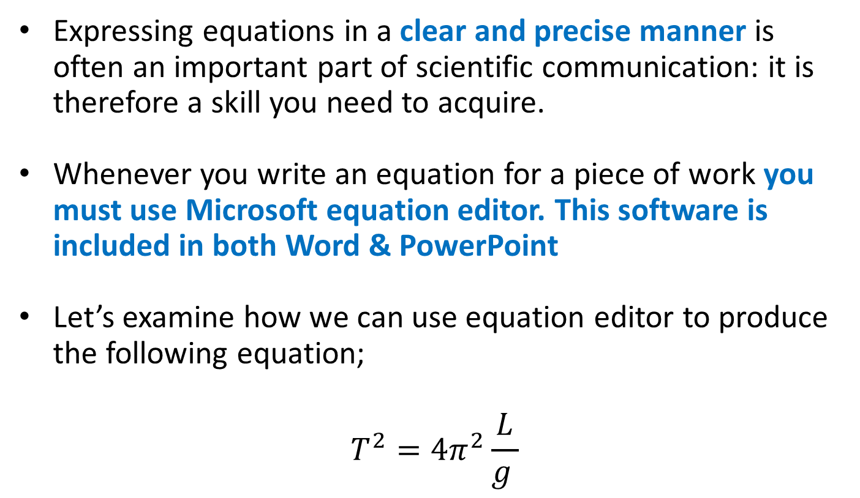
Equation Editor
Expressing equations in a clear and precise manner is often an important part of scientific communication: it is therefore a skill you need to acquire.
Whenever you write an equation for a piece of work you must use Microsoft equation editor. This software is included in both Word & PowerPoint
Let’s examine how we can use equation editor to produce the following equation;
$$T^{2}=4π^{2}\frac{L}{g }$$

Slide 8
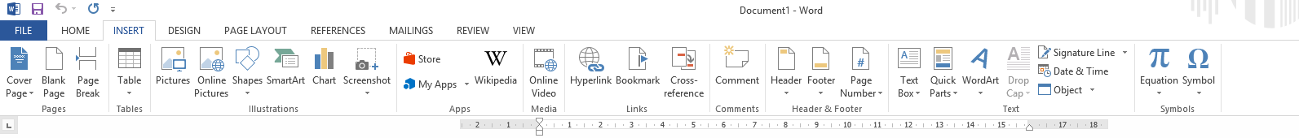
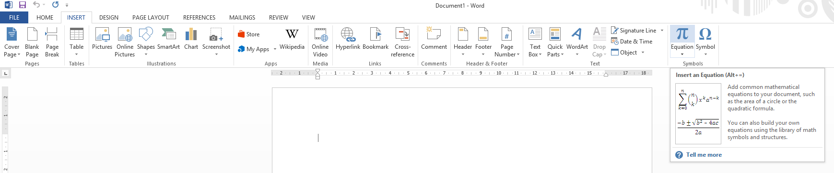
Equation Editor
Step 1: Open a new word document and click the “Insert” tab.
Step 2: Click “Equation”.

Slide 9
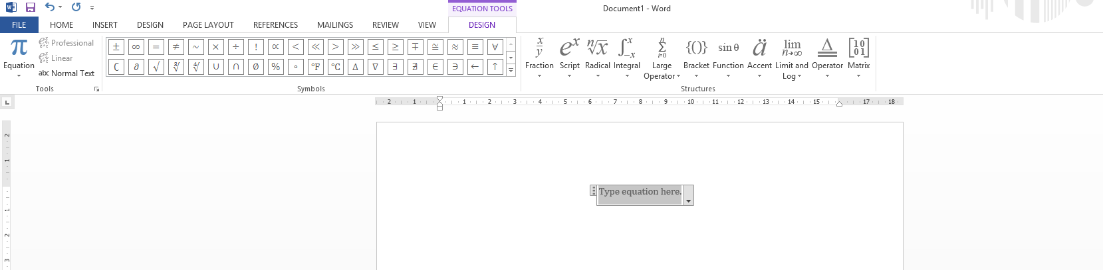
Equation Editor
Step 3: You will now have the “Equation Tools” toolbar at the top of the screen and can begin to type in your equation.

Slide 10
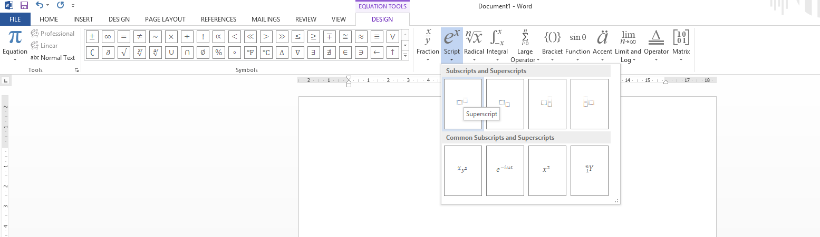
Equation Editor
Step 4: First choose “script” and then from the drop down menu “superscript”

Slide 11



Equation Editor
Step 5: You should now have something looking like this. We type “T” here and “2” here
Step 6: Next type in “= 4” to the right of the $T^{2}$term. The equation should now look like this
$$T^{2}=4$$

Slide 12
Equation Editor
Step 7: Insert another superscript to the right of the “4”

Slide 13
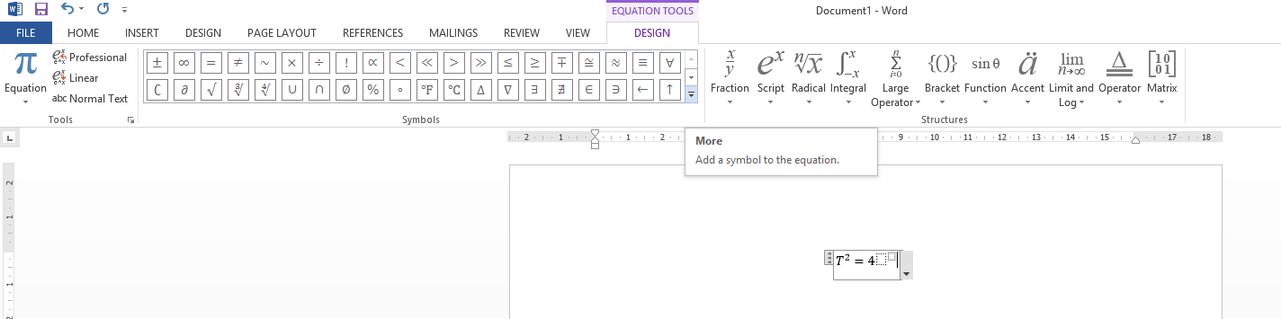
Equation Editor
Step 8: To add the symbol for π, first click on the “more” button under the list of symbols.

Slide 14
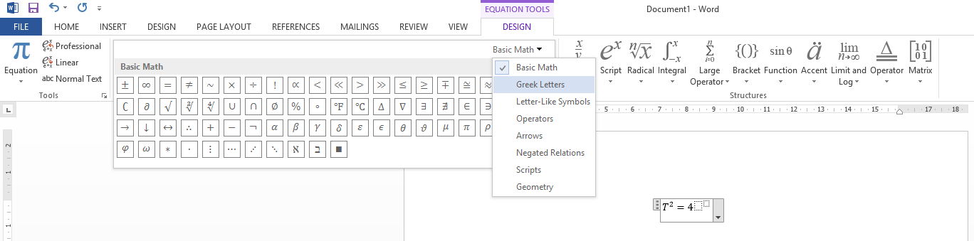
Equation Editor
Step 9: Next click on the heading “Basic Math” and change it to “Greek Letters”.

Slide 15
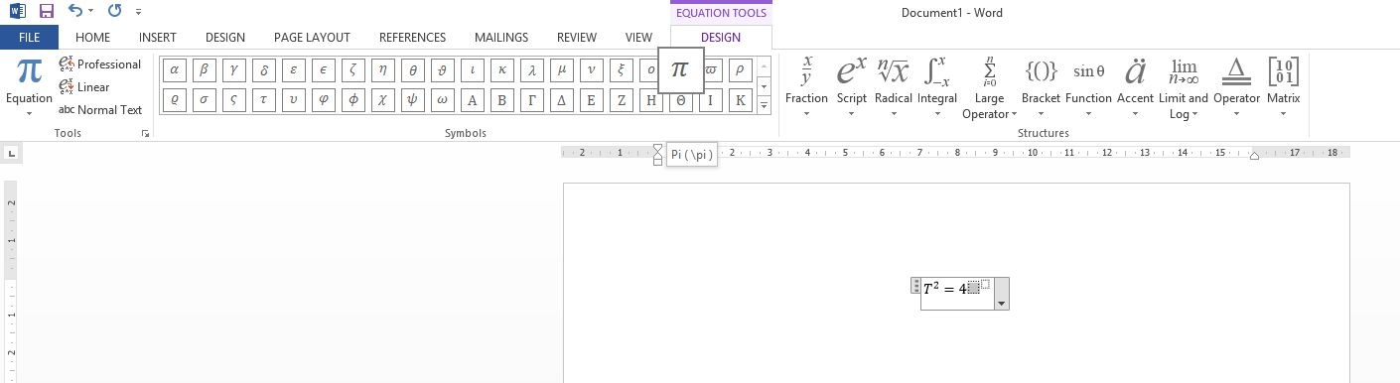

Equation Editor
Step 10: Left click where you want to place the symbol and then select “π”
Step 11: Next, type in “2” for the power. Your equation should now look like this;
$$T^{2}=4π^{2}$$

Slide 16
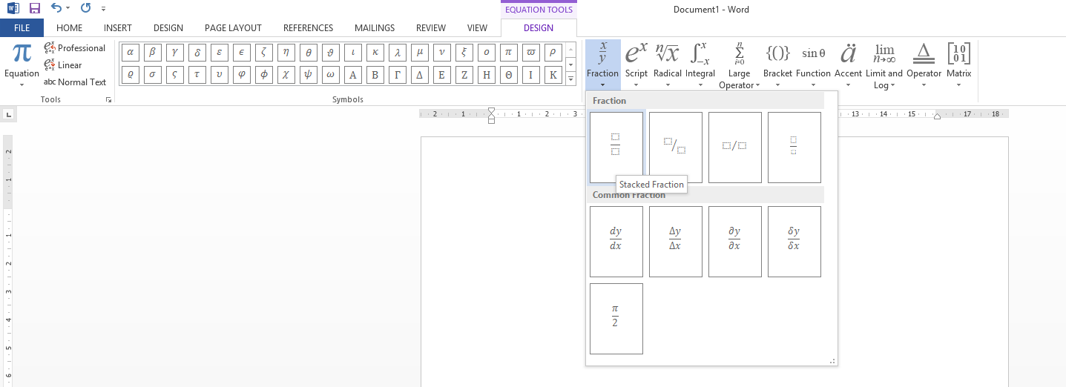

Equation Editor
Step 12: To add in the fractional term, click on “Fraction” and then “Stacked Fraction”
Step 13: Finally, type in “l” and “g”, your equation should look like the following;
$$T^{2}=4π^{2}\frac{l}{g }$$

Slide 17
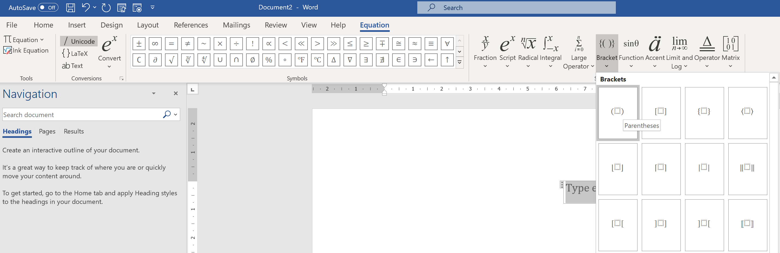

Equation Editor
Additional: When using brackets in equations always use the “Bracket button”
This will be particularly important when you have complex equations that use a lot of brackets.

Slide 18
Equation Editor
Practice: Use Microsoft equation editor to write-up the following equations;
🧐 Now check the equations you just typed – do they really look identical to those on the left? You should ask a partner to check for you as well.

Slide 19
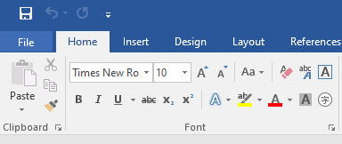
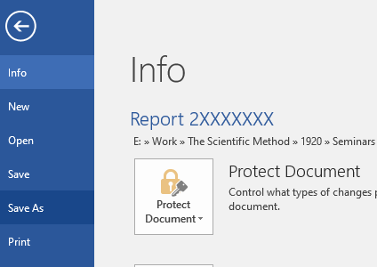
Save your Work
It’s a good idea to save this new word document in a location you can access it from later. First click “File”.
Next choose “Save as” from the left side menu

Slide 20

Save your Work
It is recommended that you save your work to a memory stick /pen drive if you bring one.
Alternatively, save your work to your OneDrive directory, your personal cloud storage. You may need to login to your university Microsoft 365 account – find Instructions
For the first time user, you will need to follow the link below to set up your University of Nottingham OneDrive Account
https://myit.nottingham.edu.cn/dwp/app/#/knowledge/KBA00003009/rkm

Slide 21


Save your Work
When saving the Word document make sure to change the title to, instead of Report 2XXXXXXX it should be “Report” followed by your ID number.
For example -

Slide 22

Producing a Report
This PowerPoint will now show you the criteria 1-6 for producing a well formatted report as well as how to implement this formatting in the form of examples.
Follow the examples on each slide and then apply these methods to any instance in the report where you think they are relevant.
For example: apply the heading formatting to all headings not just the example in this PowerPoint.

Slide 23
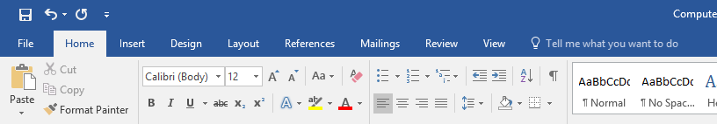
Criteria 1 – General Rules for a Report
The entire report should be fully word processed, using the following general rules:
Font: Arial, 12 point
Justification: Should be left justified
Page Number: Should be in bottom right-hand corner
Margin Size: 2.54 cm (1 inch) for right, left and bottom margins and 1.25 for the top margin.
The first step is to establish this initial formatting. Open the report in word and click on the “Home” tab.

Slide 24
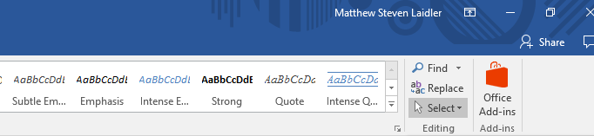
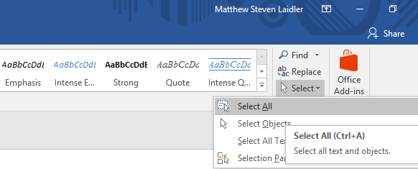
Criteria 1 – General Rules for a Report
In the top right hand corner click on “Select” drop down menu.
Then click on “Select All”.

Slide 25
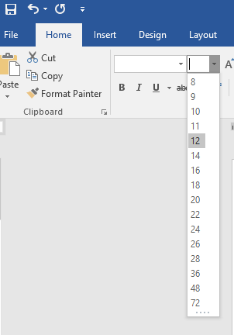
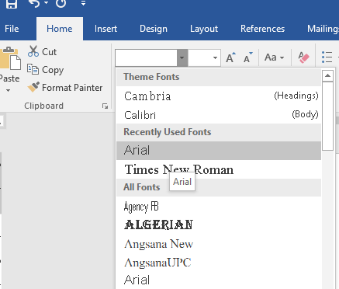
Criteria 1 – General Rules for a Report
Now we can set the font to “Arial” and the font size to “12”.

Slide 26
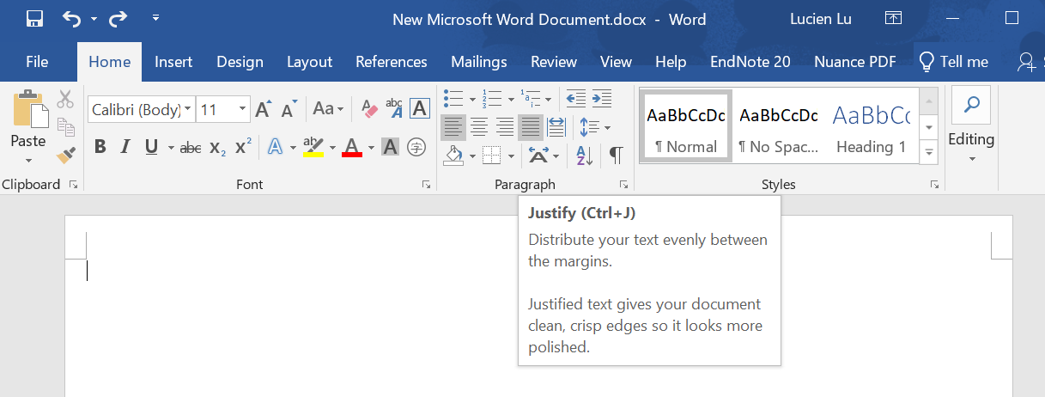
Criteria 1 – General Rules for a Report
Now we can set the alignment to “Justify”.

Slide 27
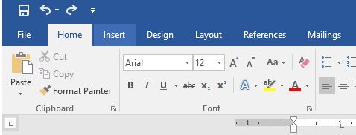
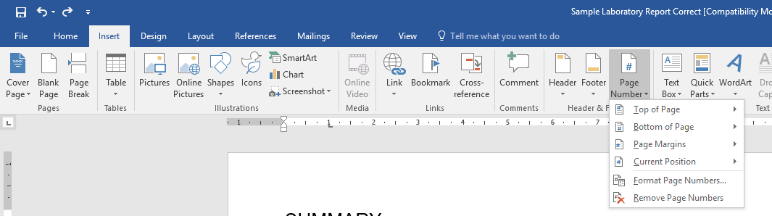
Criteria 1 – General Rules for a Report
Next we need to set the add page numbers to the document. First click on the “Insert” tab.
Next click on the “Page Number” button.

Slide 28
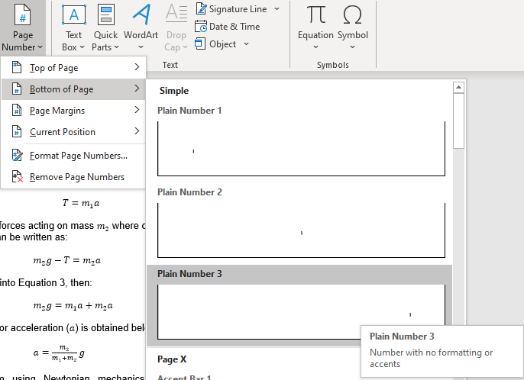
Criteria 1 – General Rules for a Report
Click “Bottom of Page”.
Choose plain “Plain Number 3”

Slide 29
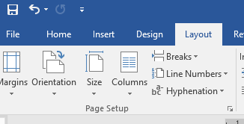
Criteria 1 – General Rules for a Report
Finally we need to set the margins for the document, first click on the “Layout” tab
Select “Margins” from the top left corner

Slide 30
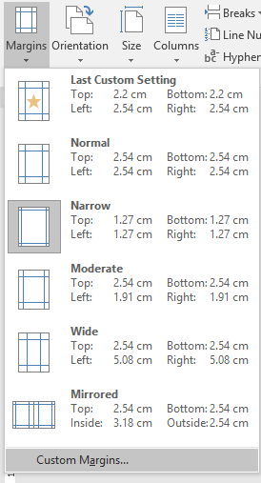
Criteria 1 – General Rules for a Report
Select “Custom margins” from the drop down menu

Slide 31
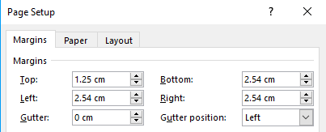
Criteria 1 – General Rules for a Report
Finally set the margins as follows
For information, 1 inch or 1” = 2.54 cm
We now have a document that follows the general format for reports. Next we are going to work on specific types of formatting to make the report easier to read.

Slide 32
Criteria 2 – Headings and Sub Headings
Each section must have a heading and in some cases a sub heading to further split it up.
Heading should be in bold Arial font and size 12
Sub-Headings, if appropriate, should be in bold Arial font size 12.

Slide 33
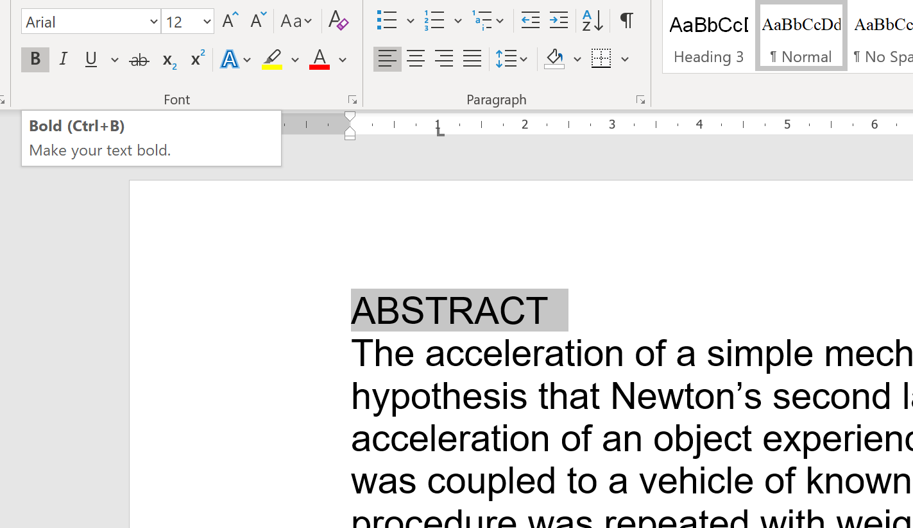
Criteria 2 – Headings and Sub Headings
The first heading in the report is “Abstract” set it to “Bold”

Slide 34
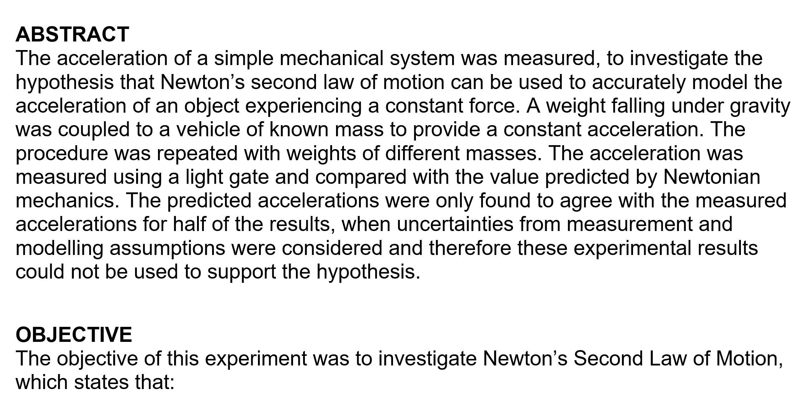
Criteria 2 – Headings and Sub Headings
Now find the rest of the headings/sub headings in the document and apply the same formatting to them.

Slide 35
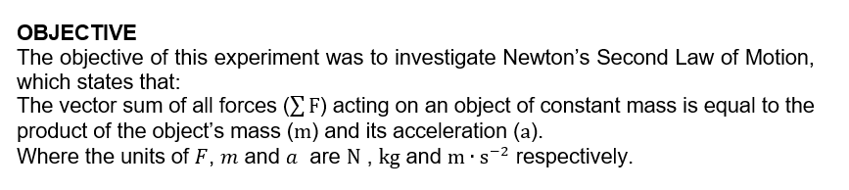
Criteria 3 – Quoting a Scientific Theory/Law
When you are quoting a scientific law, such as in the objective section, it should be separated from the body text by one line on either side. You may additionally write it in italics if you wish.
Initially the objective section will look like this;

Slide 36
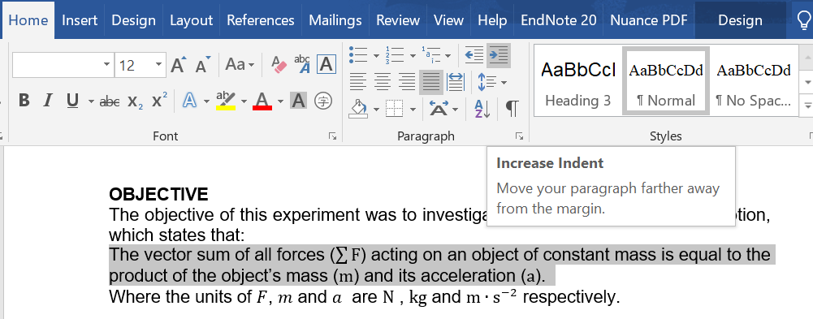
Criteria 3 – Quoting a Scientific Theory/Law
The text is already in Italics, so the first step is to indent the text. Highlight the required text and click the “Increase Indent” button once.

Slide 37
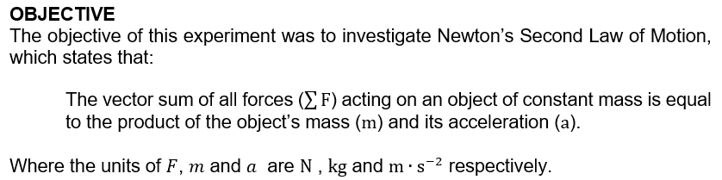
Criteria 3 – Quoting a Scientific Theory/Law
Finally we just add an extra line before and after the law. So the objective section should now look as follows;

Slide 38
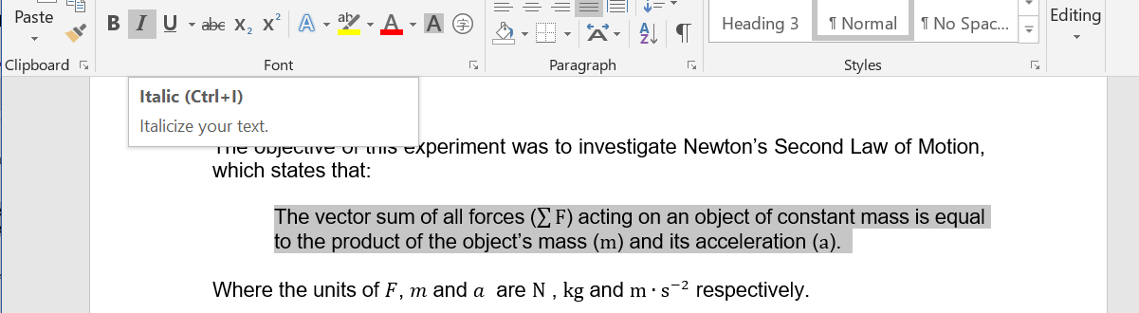
Criteria 3 – Quoting a Scientific Theory/Law
When quoting a scientific theory/law it should be in Italics, lets finish this section (for now) by setting the entire law in Italics.

Slide 39
Criteria 4 – Equations
All equations should be;
in the Cambria Math font,
written in Italics ,
centrally aligned &
numbered sequentially.
If you compare your report with the completed PDF version you will notice quite a few equations are missing. We will go through adding in the objective section one example equation in this PPT. Afterwards you should go through the rest of the report and add in all the missing equations / correct the formatting of the equations that are already there.

Slide 40
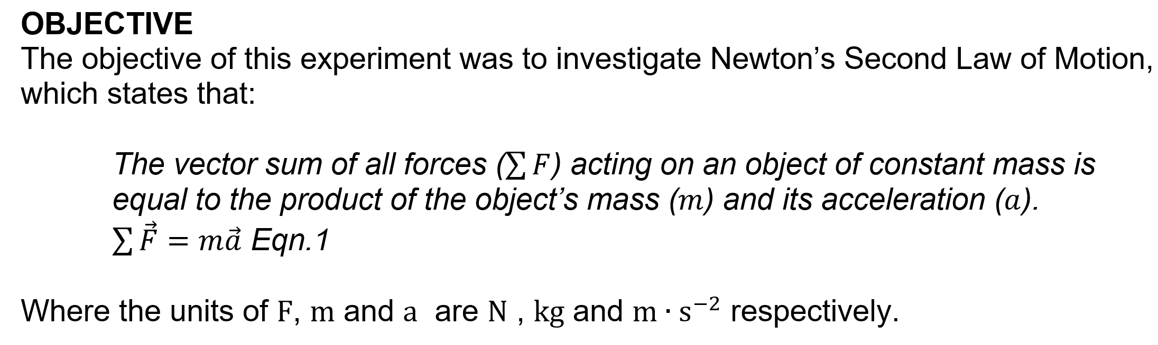
Criteria 4 – Equations
First type in “Eqn.1” (i.e., Equation 1) in Italics, where you want to insert your first equation.
Using what you have already learned about equation editor, type up Newton’s second law of motion to the left of “Eqn.1”
Your report should now look like this

Slide 41
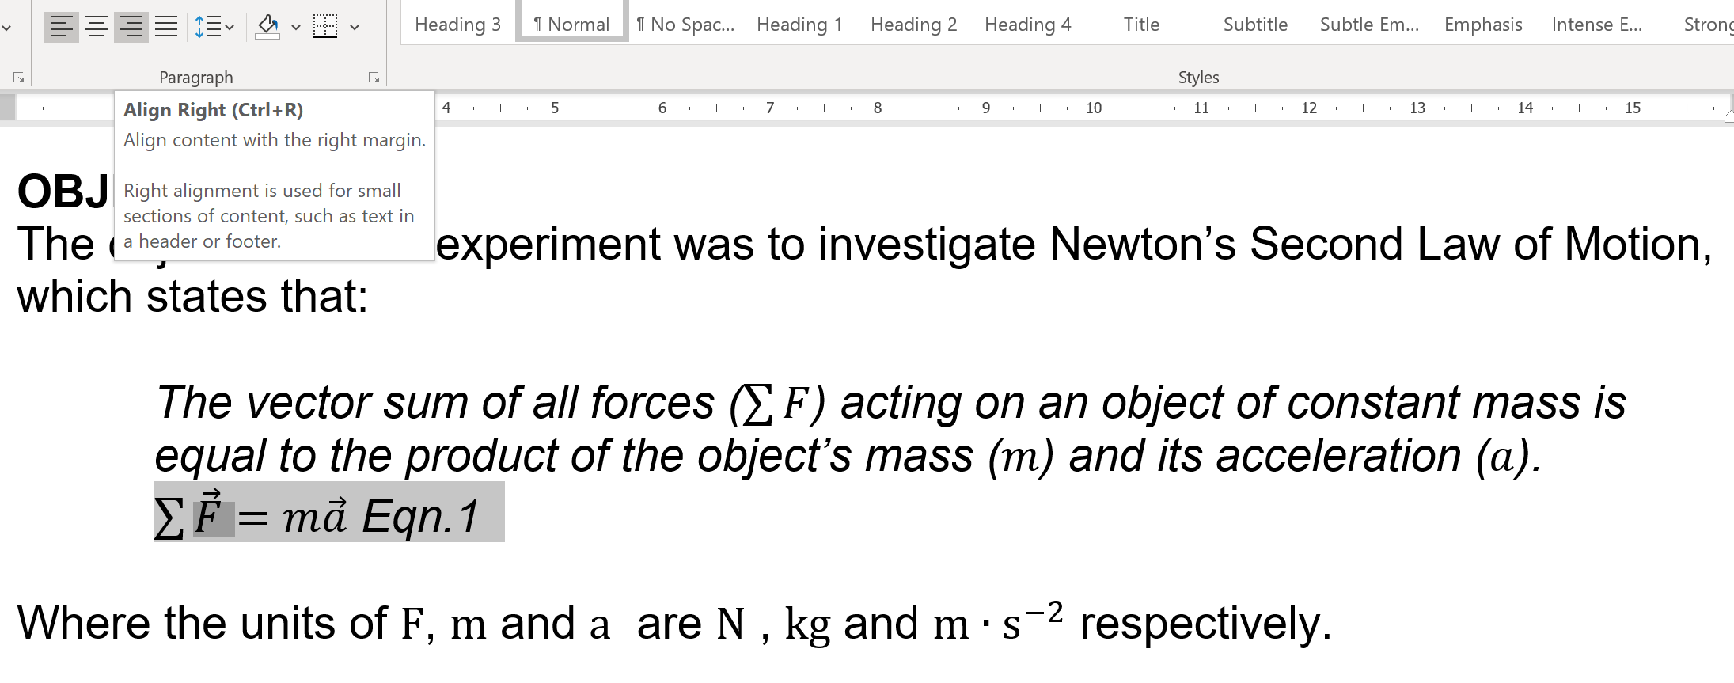
Criteria 4 – Equations
Next highlight the equation and click the “Align Right” button.

Slide 42

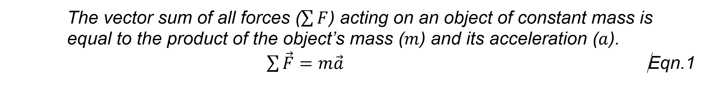
Criteria 4 – Equations
Next click between the equation and the equation number
Now press the “Tab” key on the keyboard 6 times. Your equation should now be numbered and in the centre of the page.

Slide 43
Criteria 4 – Equations
Go through the rest of the document and perform the same actions for all the rest of the equations.
Note all the equations have different lengths so you will need to adjusts the number of times you use the “Tab” key for each. For example;

Slide 44
Criteria 5 – Tables
Any scientific report will inevitably contain tables of data, either direct measurements or calculated values.
Tables should be;
titled above,
sequentially numbered (table number should be in bold),
presented on a single page with the title,
labelled with appropriate units at the top of the columns &
aligned to the centre of the page with each column additionally centrally aligned.

Slide 45
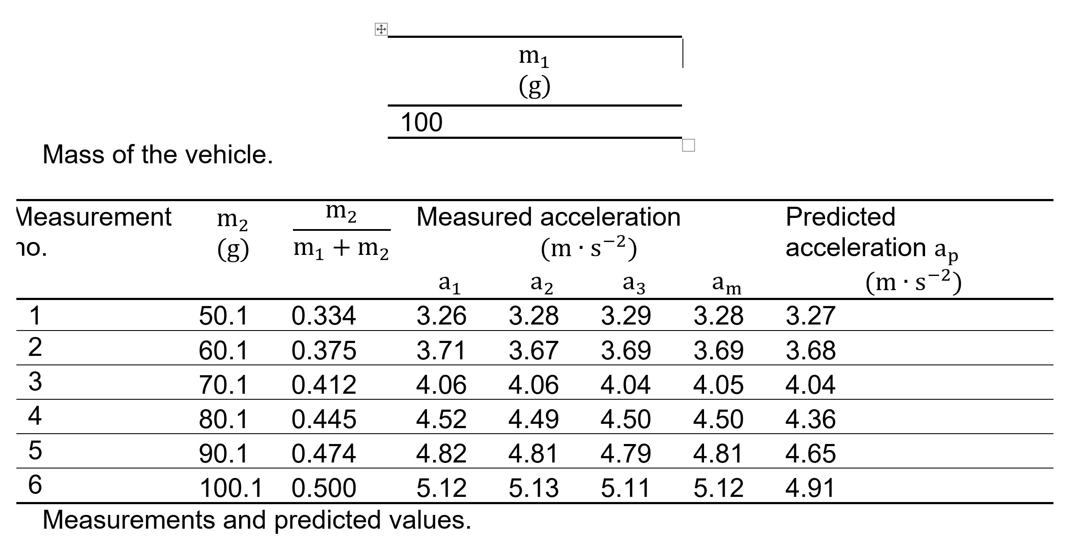
Criteria 5 – Tables
Consider the first two tables in the report, shown below.
Both tables need to be numbered as “Table 1.” and “Table 2.” respectively.

Slide 46
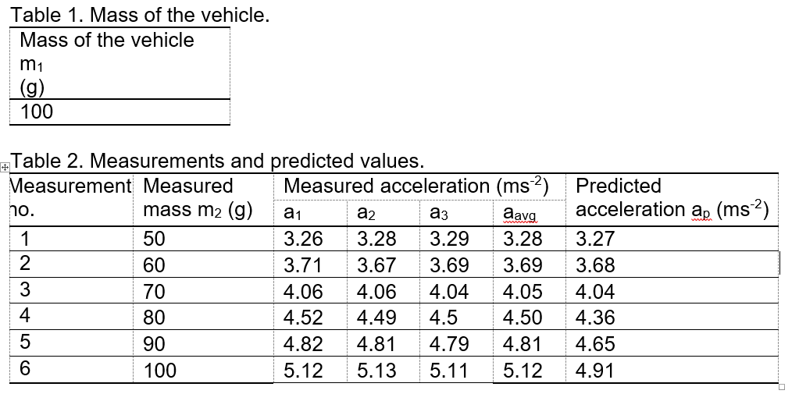
Criteria 5 – Tables
Both tables should be numbered as “Table 1.” and “Table 2.” respectively.
Both tables should be labelled above rather than below. Make these changes and your tables should now look like this;

Slide 47
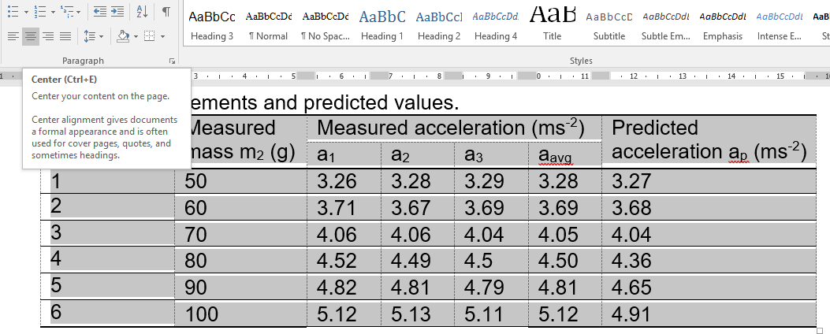
Criteria 5 – Tables
Finally all of the columns need to be centrally aligned to do this highlight all of the cells in the table
Click the “Centre” aligned button.
Go through the rest of the document and correct any additional tables.

Slide 48
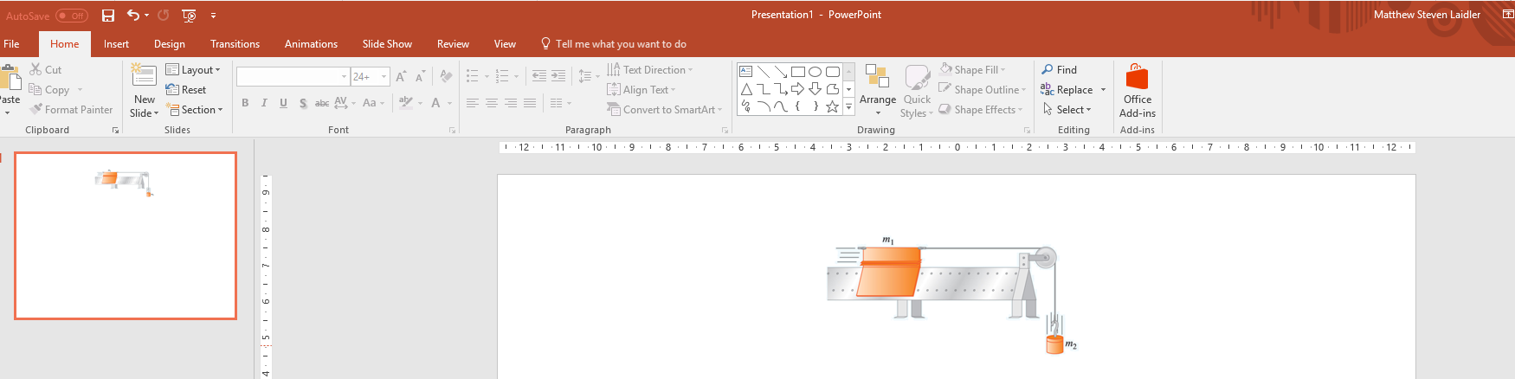
Criteria 6 – Figures
Frequently in 1st year you will be given a diagram which you are expected to label. In the example report the diagram in the introduction section has not been labelled.
The first thing to do is to copy this diagram in to a blank PowerPoint slide as shown below.

Slide 49
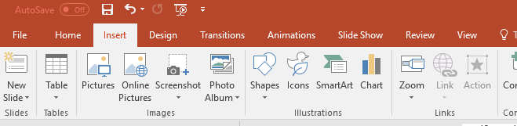
Criteria 6 – Figures
To represent the forces acting on the two masses we will use arrows. To add them, first click on the “Insert” tab.
Then click on “Shapes”.

Slide 50
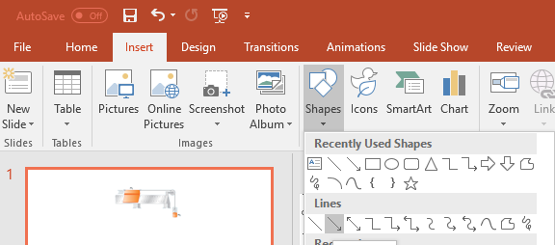
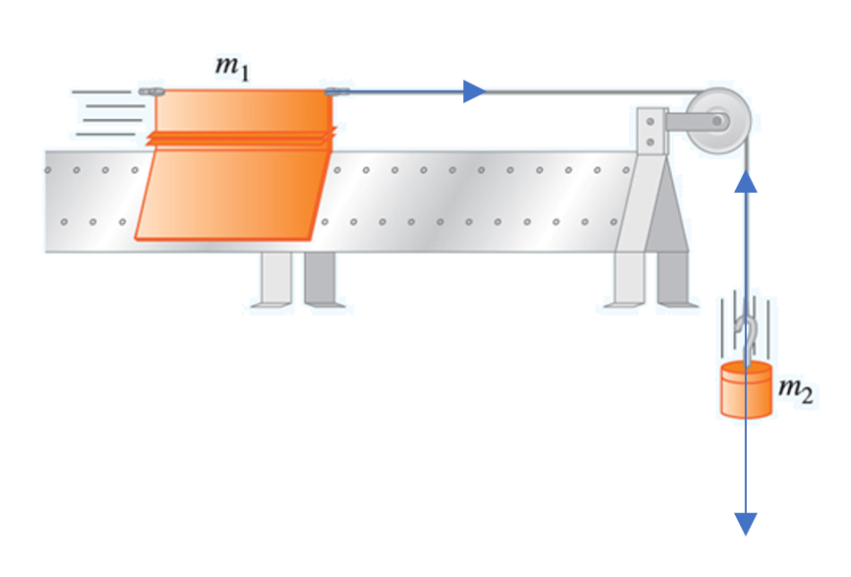
Criteria 6 – Figures
Finally click on the arrow.
Now draw the 3 arrows on your diagram as shown below;

Slide 51
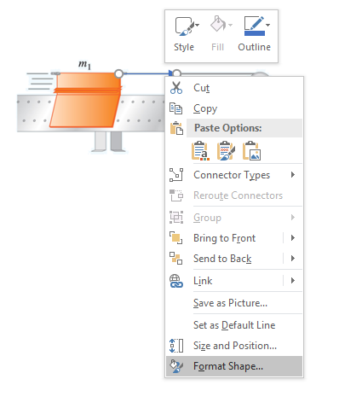
Criteria 6 – Figures
In order to make the arrows stand out we need to format them. To do this select an arrow and then right click and select “Format Shape” from the menu.

Slide 52
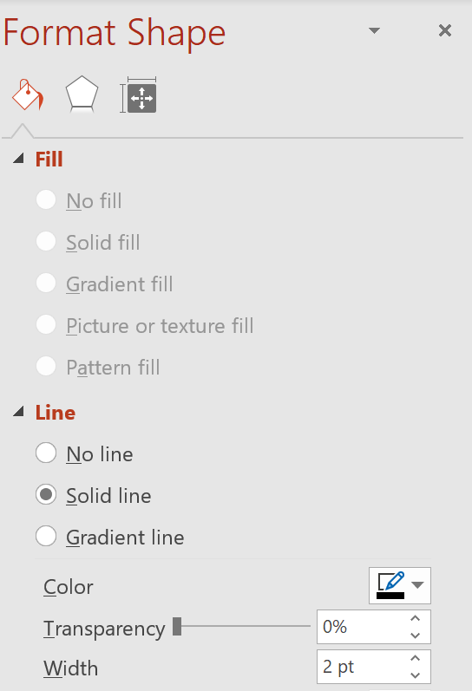
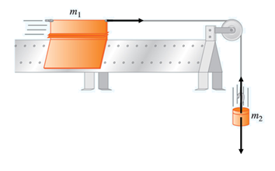
Criteria 6 – Figures
This will bring up a menu on the right side of the screen. Set the “Width” of the line to “2” and the “Colour” to black.
Repeat this process for the other 2 lines.

Slide 53

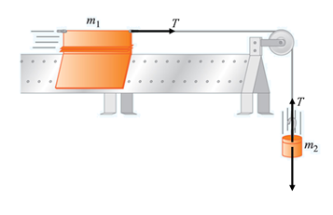
Criteria 6 – Figures
Now we need to label the forces. Click on the “Insert” tab again and this time select “Equation”.
In the box created type “T”, use this to label the two forces as shown below.

Slide 54
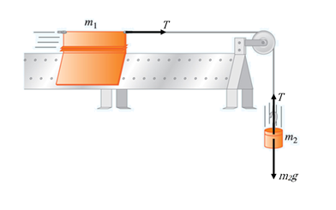

Criteria 6 – Figures
Use the same method but this time type in “$m_{2}$g” for the weight and label the last force as shown below.
Finally we need to copy the diagram back in to word.

Slide 55
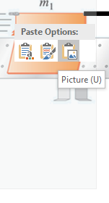
Criteria 6 – Figures
Select all of the objects, the diagram, the labels and forces. Once selected right click and choose “Copy”.
Go back to the word report and delete the original diagram.
Right click where it used to be and from the menu choose “Paste Options” and then click on “Picture”.

Slide 56
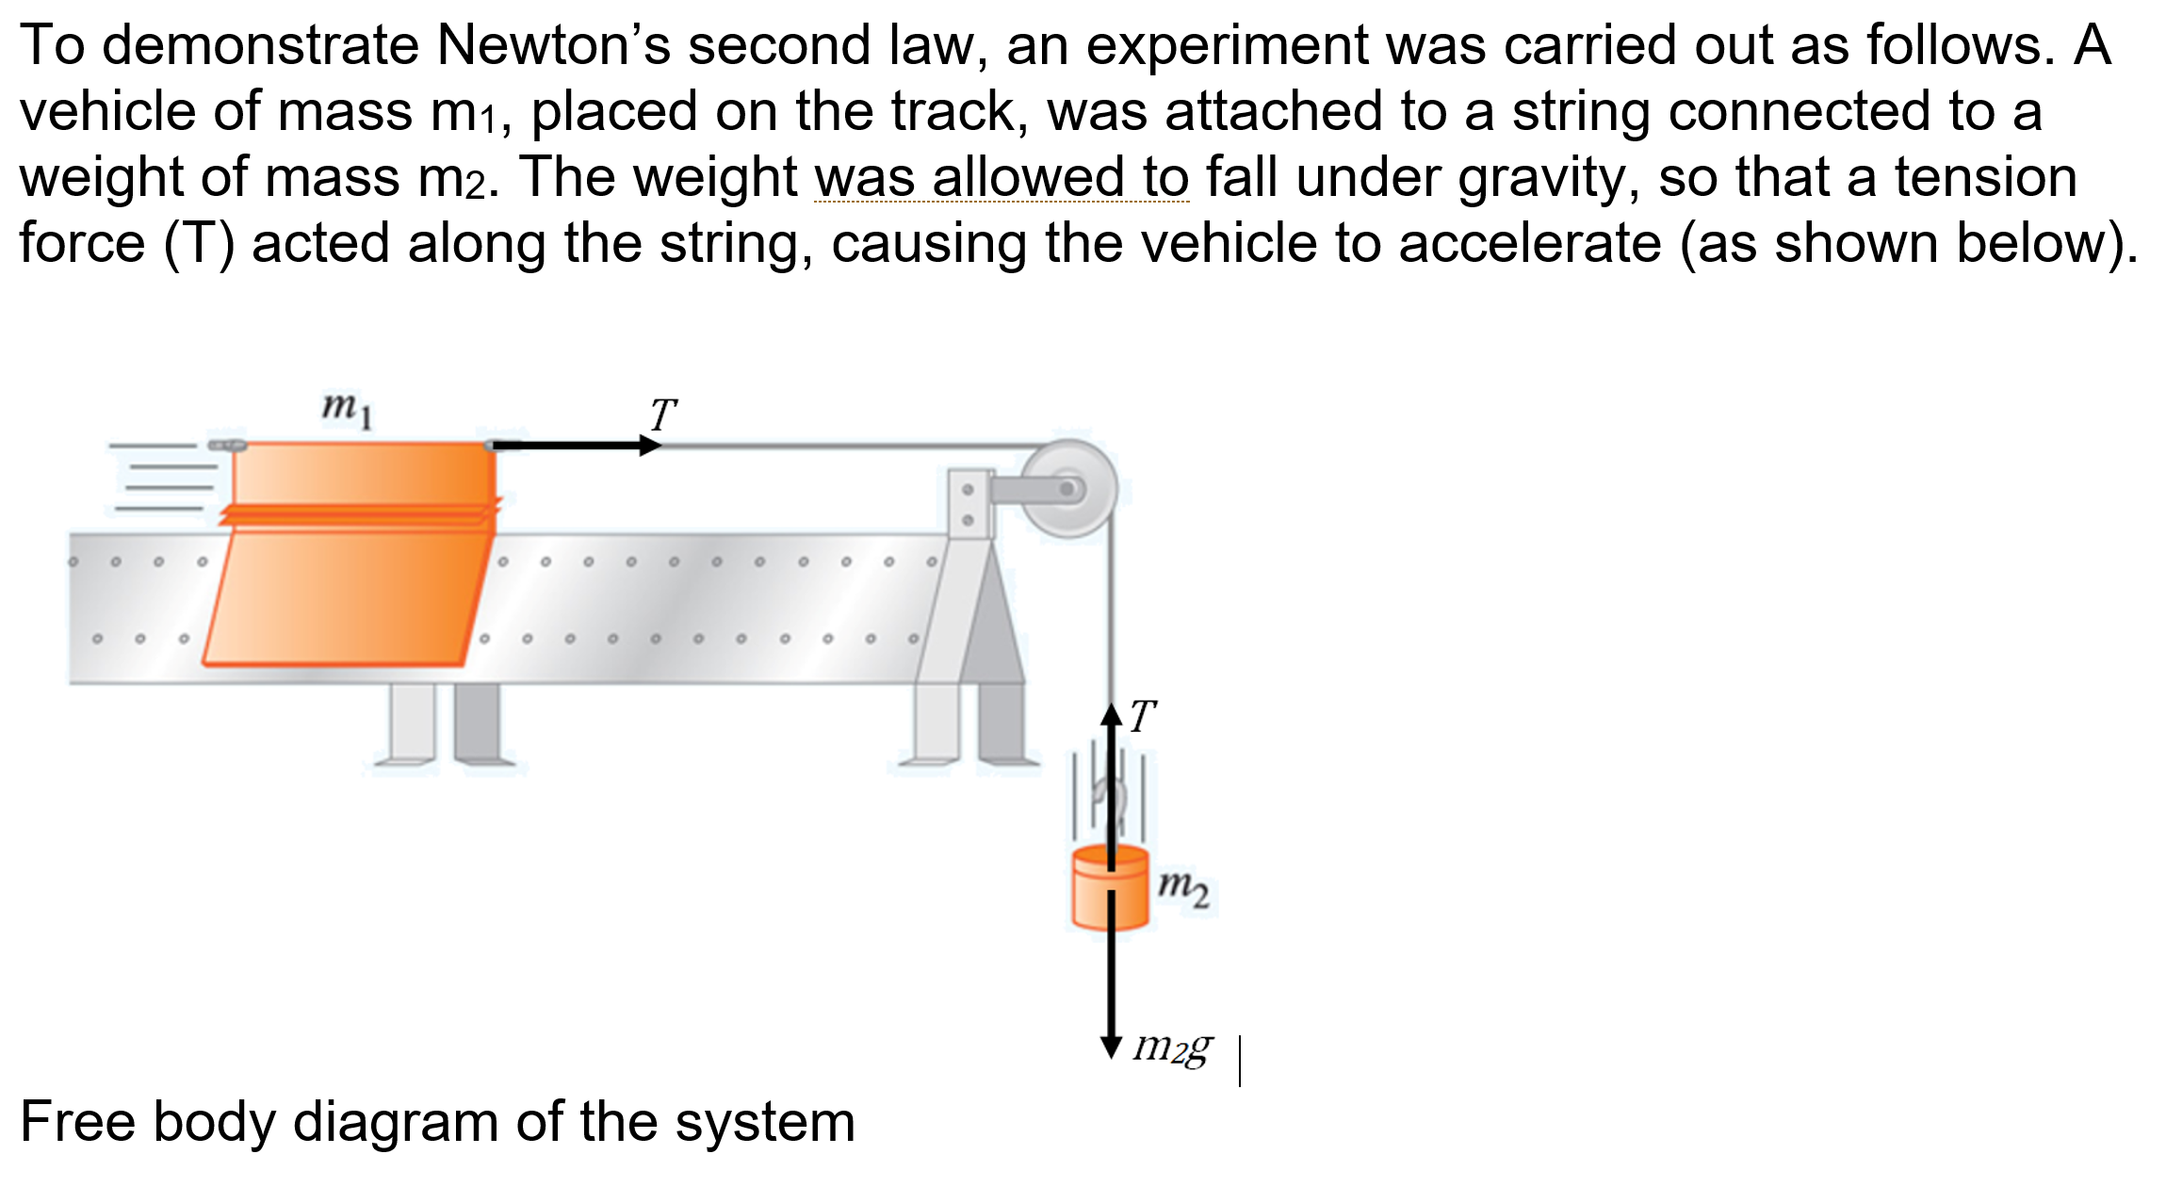
Criteria 6 – Figures
The diagram is now correctly labelled and your report should look like the diagram below.

Slide 57
Criteria 6 – Figures
Now that the figure is labelled we can look at how we format figures.
Figures should be
titled below,
sequentially numbered (the Figure Number should be in Bold),
centrally aligned &
presented on a single page with the title.
The figure we have just labelled is the 1st figure in the report so we title it as “Figure 1.” and it needs to be centrally aligned, as shown on the next slide.

Slide 58

Criteria 6 – Figures
Now go through the rest of the report and format any additional figures. Note that we consider graphs to be figures.

